Slide 1
Benchmark Test Results
1st Quarter Dream Team
Language Arts Classes

Slide 2
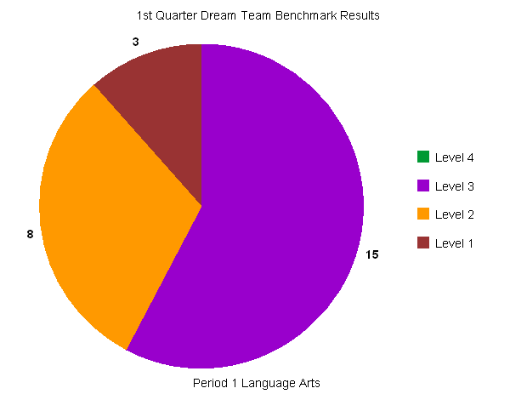
Period 1

Slide 3
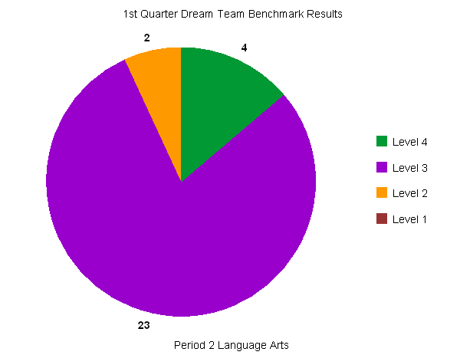
Period 2

Slide 4
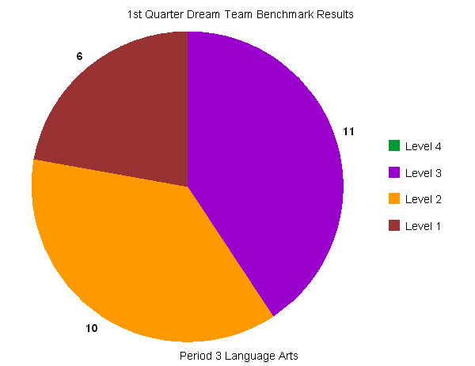
Period 3

Slide 5
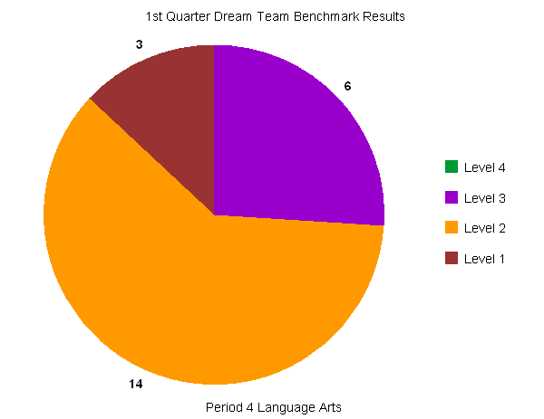
Period 4

Slide 6
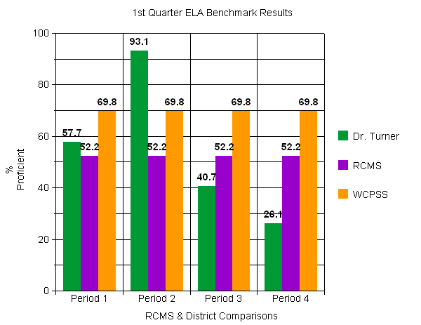
Schoolwide/District Comparisons

